Slide 1


Green Pace
Security Policy Presentation
Developer: Zachariah A Garrison.
CS-405 Secure Coding
08/17/2025

Slide 2

OVERVIEW: DEFENSE IN DEPTH
The security policy document created for Green Pace is designed to ensure that the company and its customer base is protected at every step of the way. By utilizing a layered security system known as Defense-in-Depth, we can build a strong defense that will help protect the confidentiality, integrity, and availability of the systems at Green Pace.

Slide 3
THREATS MATRIX
The matrix categorizes the 10 coding standards by likelihood and priority. The “Likely” section is high-severity, high-likelihood vulnerabilities that pose immediate risks of crashes and exploits. The “Priority” section addresses probable risks with significant impact. The “Low Priority” section includes probable but less urgent issues. The “Unlikely” section covers low-likelihood risks but all require attention and monitoring.
Likely STD-005-CPP (P27) STD-001-CPP (P18) STD-003-CPP (P9) STD-004-CPP (P9) | Priority STD-002-CPP (P12) STD-008-CPP(P8)
Low priority STD-006-CPP (P6) STD-007-CPP (P6) STD-010-CPP (P6) | Unlikely STD-009-CPP (P2)
Automated tools such as Clang-Tidy and Cppcheck can be integrated into CI/CD pipelines to detect these vulnerabilities early, reducing risk and keeping on schedule.

Slide 4
10 PRINCIPLES
Security Principle | Examples | Provided Security Risks
Validate Input Data | Data Type Data Value | STD-001-CPP STD-003-CPP STD-004-CPP STD-006-CPP STD-008-CPP
Heed Complier Warnings | Deprecated Functions Unused Variables
Architect and Design | Role-Based Access Control Data Encryption
Keep It Simple | Minimal Dependencies Straightforward Logic | STD-002-CPP STD-008-CPP
Default Deny | Firewall Rules User Permissions
Adhere to the Principle of Least Privilege | Database Accounts Admin Tools | STD-009-CPP STD-010-CPP
Sanitize Data Sent to Other Systems | SQL Queries HTML Output | STD-004-CPP
Practice Defense in Depth | Multi-Factor Authentication Network Segmentation | STD-003-CPP STD-004-CPP STD-005-CPP STD-007-CPP STD-009-CPP STD-010-CPP
Use Effective Quality Assurance Techniques | Code Reviews Automated Testing | STD-001-CPP STD-002-CPP STD-005-CPP STD-006-CPP STD-007-CPP
Adopt a Secure Coding Standard | SEI CERT C++ OWASP | All Standards

Slide 5
CODING STANDARDS
Standard | Label | Description | Priority
STD-005-CPP | MEM52-CPP | Detect and handle memory allocation errors. | P27
STD-001-CPP | INT32-C | Prevent signed integer overflows | P18
STD-002-CPP | EXP53-CPP | Initialize all variables | P12
STD-003-CPP | STR31-C | Ensure sufficient space for strings | P9
STD-004-CPP | STR02-C | Sanitize data passed to subsystems | P9
STD-008-CPP | EXP50-CPP | Avoid Undefined evaluation order | P8
STD-006-CPP | EXP54-CPP | Validate object lifetime with assertions | P6
STD-007-CPP | ERR51-CPP | Handle all exceptions | P6
STD-010-CPP | CON51-CPP | Release locks on exceptions | P6
STD-009-CPP | FIO51-CPP | Close files when no longer needed | P2
The coding standards are listed in order of priority and the threat/impact they may have left unchecked.
Each standard addresses specific vulnerabilities such as overflows, resource leaks, and common errors.

Slide 6
ENCRYPTION POLICIES
Encryption at Rest: This form of encryption protects data stored on disk or in databases, this prevents unauthorized access if storage is compromised. Using encryption methods such as AES-256 can encrypt sensitive data stored in these databases or files.
Encryption in Flight: Encryption in flight secures data being transmitted over networks, this can prevent interception or tampering. By using encryption for all network communications such as web traffic, and enforcing HTTPS for all web interfaces and validation certificates can prevent man-in-the-middle attacks. This policy covers all data transmitted between clients, servers, and third party services.
Encryption in Use: Encryption in use protects data while it is being processed in memory. Using secure encryption for sensitive computations and ensure memory is cleared after use can prevent data leaks. This policy applies to applications processing sensitive data which can protect against memory-based attacks.

Slide 7
TRIPLE-A POLICIES
Authentication: Authentication verifies users or system identity before granting access. By implementing multi-factor authentication for all user logins and having secure login information (passwords) is a form of authentication. This policy should apply to all user and system access points, including logins and administrative interfaces, which will prevent unauthorized access.
Authorization: Authorization is used to define user or system permissions based on their role. By placing role based access you can manage the level of access users may obtain. This can also give permissions and restrict access to sensitive information and can limit the modifications to databases.
Accounting: Accounting tracks and logs all user and system activities, by logging all user login and activities will allow you to ensure all users stay within their bounds and logs can be checked for any issues and can allow compliance for regular maintenance.

Slide 8
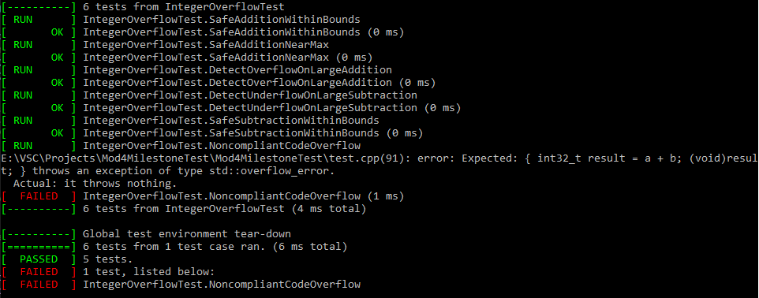
Unit Testing
We will look over unit testing for vulnerability STD-001-CPP, Integer Overflow. I ran six tests that verify that compliant code prevents integer overflows and underflows, while noncompliant code exposes risks.

Slide 9
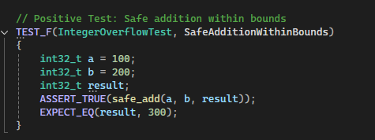
Unit Testing – Does Safe Addition Within Bounds Prevent Integer Overflow?
Vulnerability: Integer Overflows cause undefined behavior, risking crashes or exploits.
Test: This test verifies that adding two small int32_t values (100 + 200) produces the correct result (300) without overflow.
Results: Results show the test passed, confirming the safe addition.
Further Testing: Using external tools like Clang-Tidy can detect potential overflows. Also you can simulate adding random inputs for more robust bound checks.

Slide 10
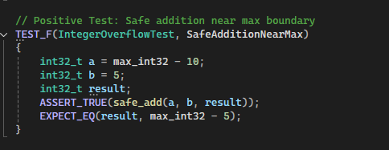
Unit Testing- Does Safe Addition Near Max Boundary Prevent Integer Overflow?
Vulnerability: Integer overflows near INT32_MAX risks undefined behavior.
Test: Tests addition of a value near INT32_MAX (MAX – 10 + 5) to ensure no overflow occurs.
Results: Test passed confirming safe addition near boundary.
Further Testing: Can use Coverity (INTEGER_OVERFLOW_ to flag risky arithmetic operations. Also implementation of static assertions can compile time checks.

Slide 11
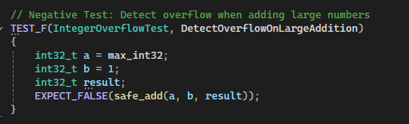
Unit Testing- Does the Code Detect Overflow on Large Addition?
Vulnerability: Adding large numbers can cause overflows, leading to exploits.
Test: Verifies that safe_add detects overflows when adding INT32_max and 1.
Results: Test passed confirming overflow detection.
Further Testing: Cppcheck (integerOverflow) flags potential overflow risks. Also using SafeInt library for robust bound checks.

Slide 12
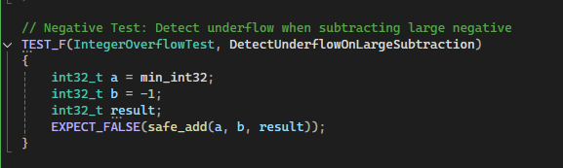
Unit Testing- Does the Code Detect Underflow on Large Subtraction?
Vulnerability: Subtracting large negative numbers risks underflow.
Test: Tests if safe_add detects underflow when subtracting from INT32_MIN.
Results: Test passed confirming underflow detection.
Further Testing: Clang-Tidy (Cert-int32-c) ensures underflow detection. Also add logging for underflow events to aid in debugging issues.

Slide 13
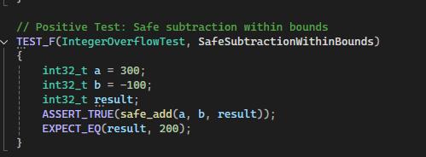
Unit Testing- Does Safe Subtraction Within Bounds Prevent Integer Overflow?
Vulnerability: Subtraction can cause underflow if not properly checked.
Test: Verifies safe subtraction of a negative number (300 – (-100) within bounds.
Results: Test passed confirming safe subtraction.
Further Testing: Coverity (INTEGER_OVERFLOW) ensures safe operations. Use automated “fuzzing” or invalid testing to confirm edge cases.

Slide 14
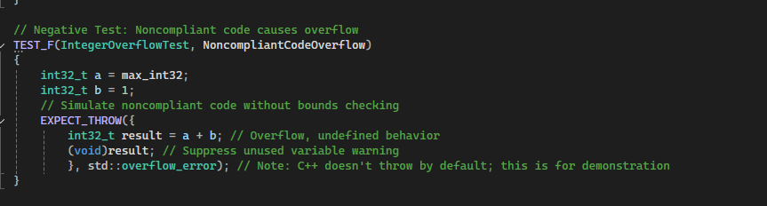
Unit Testing- Does Noncompliant Code Cause Integer Overflow?
Vulnerability: Noncompliant code without bounds checking can risk overflows.
Test: Simulate using noncompliant code adding INT32_MAX and 1, expecting exception.
Result: Test failed as C++ doesn’t throw std::overflow_error for overflows, this highlights the vulnerability.
Further Testing: Clang-Tidy (Cert-int32-c) flags missing bounds checks. Enforce bound checking libraries such as SafeInt in production code to ensure vulnerabiites such as this do not slip.

Slide 15

AUTOMATION SUMMARY

Slide 16
TOOLS
DevSecOps: The pipeline integrates security practices into the traditional DevOps lifecycle, ensuring security is a continuous process from development to production.
1. Assess and Plan (Yellow/Blue): Involves analyzing the threat landscape, regulations, and impacts.
2. Design and Build (Black/Gray): Focus on creating secure builds using trusted repositories and secure open-source usage.
3. Verify and Test (Gray): Scanning for vulnerabilities, testing trusted source code, and conducting tests to ensure security, compliancy, and functionality.
4. Transition and Health Check (Gray/Black): Configuring and deploying systems, setting security parameters, and conducting tests to validate the product’s readiness.
5. Monitor and Detect, Maintain and Stabilize, Respond (Black/Yellow/Blue): Monitor logs, perform analytics, and detects intrusions. Maintain security baseline and stabilize after attempted attacks. Ensure proper response to attacks such as blocking the attack, turning off service, or rolling back changes.
OWASP (Open Web Application Security Project): Provide security driven guidelines and best practices to prioritize threats and secure development.
SIEM (Security Information and Event Management): Collects logs, performs analytics, and enables intrusion detection for real-time security monitoring.
Various other tools such as Parasoft, Cppcheck, etc., can be used in testing portions of design to check for vulnerabilities during and after development.

Slide 17
RISKS AND BENEFITS
Pros:
By having security as a focus from planning to post development, you can have a more secure and ready to deploy product.
Will lead to better, cleaner, and dependable code that is secure.
Provide a better defense from attacks and will lead to less damage if an attack were to occur.
Encourages consistency among team members throughout the entire SDLC process.
Cons:
Can have more upfront cost. (But can reduce long term costs by catching issues early in development)
Requires skilled development teams as development can become more complex and increased size.
The increase in work and size may push timelines and customers/stakeholders may find this to be an issue.
What about just waiting to focus on security?
Trying to add security features in after development and planning are over can lead to complications, missed vulnerabilities, and is a much more difficult process than starting from the beginning.
Increased risk of attacks, vulnerabilities, and data breaches.
While focusing on security can have higher upfront costs, the cost of not addressing security issues early one can lead to longer development time to go back and retrofit security (mentioned above) and the vulnerabilities left unchecked can lead to attacks which could have drastic cost and more.

Slide 18
RECOMMENDATIONS
Training: Proper training is one of the biggest steps in security, ensuring that those working on the application and those involved after are fully trained and vested into what is being put into the product. Creating a firm understanding of the importance of security from beginning to end, as well as why it is important to have a focus of security are paramount. Take time to review cases in which security failures led to large consequences such as https://www.upguard.com/blog/biggest-data-breaches-us‌ which goes over some of the largest breaches in US history. By providing examples it can drive home the impact of why security is important at all stages of SDLC.
Cover All Gaps: While many different vulnerabilities are covered the list can be endless and each deserves its own attention. Taking the time to reference resources such as SEI CERT C++ Coding Standard (SEI CERT C++ Coding Standard - SEI CERT C++ Coding Standard - Confluence, n.d.) throughout and after development can help identify issues potentially not even realised.
Set Standards: Adopt certain security standards that should be followed for this development and any future development. Having higher standards on the stance of security, code quality, and the continued improvement/learning of the staff can lead to more secure and better applications being featured.
Continued Review: Even after development ends, continue to review previous work for vulnerabilities and newer threats. As we progress in the way we approach development so do those who try to attack our work. Have team members review the OWASP Top Ten (OWASP, 2021) and similar sources like it to always be prepared for the biggest threats but also learning what new threats may be coming.

Slide 19
CONCLUSIONS
Security policy ensures secure and compliant development that aligns with best practices, make it a standard.
Using automation testing and unit testing can reduce vulnerabilities effectively while not requiring much longer development time.
Continue to improve through gap analysis and by taking a proactive stance rather than a “we will do it later” style.
Remember that deciding to wait, rather than implement, can lead to large consequences. Equifax data leak could have been completely avoided just by doing routine updates and security checks, rather than go through the slight inconvenience of doing these updates 143 million people had sensitive information stolen from them, unknowingly (Fruhlinger, 2020). Take the time to make security a priority and not an afterthought.

Slide 20
REFERENCES
Chin, K. (2024, December 30). Biggest data breaches in US history. UpGuard. https://www.upguard.com/blog/biggest-data-breaches-us‌
Fruhlinger, J. (2020, February 12). Equifax data breach FAQ: What happened, who was affected, what was the impact? CSO Online. https://www.csoonline.com/article/567833/equifax-data-breach-faq-what-happened-who-was-affected-what-was-the-impact.html
OWASP. (2021). OWASP Top Ten. Owasp.org; OWASP. https://owasp.org/www-project-top-ten/
SEI CERT C++ Coding Standard - SEI CERT C++ Coding Standard - Confluence. (n.d.). Wiki.sei.cmu.edu. https://wiki.sei.cmu.edu/confluence/pages/viewpage.action?pageId=88046682

